Slide 1
Office 365 Account Management
Hari Thapliyal
Agilest & Project Management Trainer, Coach & Consultant
MBA, MCA, PGDOM, PGDFM, CIC, PMP, PMI-ACP, PRINCE2 Trainer MCITP, MCTS, CSM, SCT, MCT, SPOC, SMC, SAMC

Slide 2
My Motivation
Purchasing some Office® or Project® or Project Server® licensing is so much confusing at Microsoft site that only those like me who wasted many days or wasted money by making wrong decision know the pain. You do not find all the information at one place with uniform linking and relation between their dozens of sites and hundreds of link.
I thought using this presentation I will be able to help some people in saving time and making right decision.
I am not Microsoft representative but based on my experience if I can help you in making right decision and saving time then I will consider myself fortunate and will try my best. Therefore do not hesitate to write me if you need any critical or important information from me to make your decision.
This presentation is with real screen snapshots and links so that you know what it looks like at what link (before purchase or after purchase of office 365 license)

Slide 3
Why Office365
Microsoft has two kind of licenses 1- Cloud Based 2- Perpetual. Pricing, support, upgrade, maintenance, ownership etc. of these two group of licenses are completely different.
If you want to buy any cloud based product then you need to have 365 Account.
For “office” range of products and “Project” you need to have “Office 365” account
For Dynamics you need to have “Dynamics 365” Account
For Azure you need to have “Auzre” Account
Under “Office 365” you can have 2 types 1- Home 2- Work, Student, University Account
Using “Home Office 365” Account you can purchase products only for home use.
Using “Work Office 365” Account you can purchase products for Business and Enterprise need.
Office product has 3 main types: 1- “Home Office 365” 2- “Business Office 365” - Work, student, university 3- “Enterprise Office 365” Account
Under Home, Business and Enterprise there are again different kind of licenses. Based on your need you can select, pay and subscribe.
After you subscribe you can download and install the client of the software on your machine. But your upgrade, patches etc is taken care by Microsoft for the period of subscription.

Slide 4
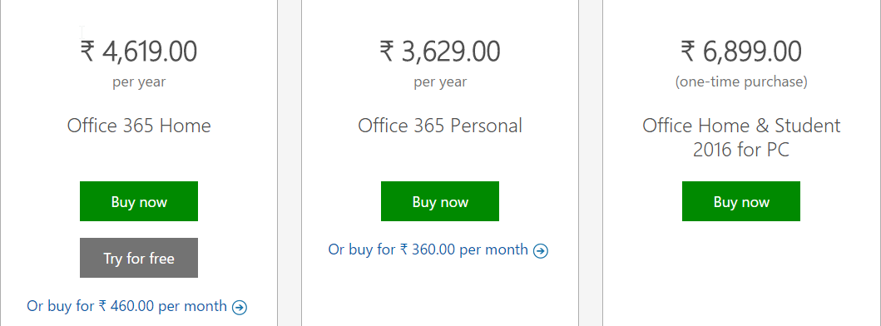
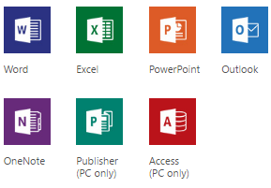
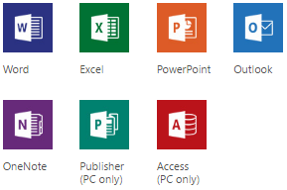
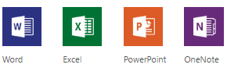
Pricing & Application “Microsoft Home Office”
Home (Yearly Cost)
https://products.office.com/en-in/compare-all-microsoft-office-products?tab=1
Can be installed on 5 pc/macs/tablet/phone/machines/devices

Slide 5
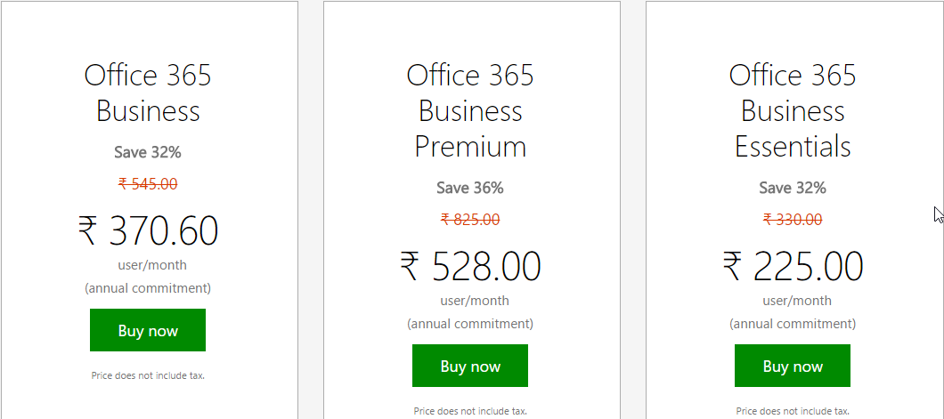
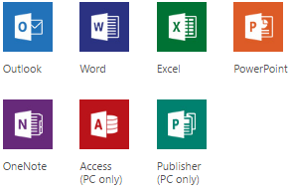
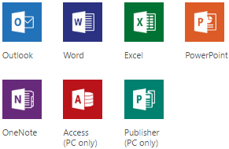
Pricing & Application “Microsoft Business Office”
Business (Monthly Cost)
https://products.office.com/en-in/compare-all-microsoft-office-products?tab=2
- No Office App
- Only Services

Slide 6
Office Perpetual License
Office Home & Student 2016 -> One downloadable copy for Windows
Word, Excel, PowerPoint, OneNote
Office Home & Business 2016 -> Fully installed versions for 1PC.
Outlook, Word, Excel, PowerPoint, OneNote
Office Professional 2016 -> Fully installed versions for 1PC.
Outlook, Word, Excel, PowerPoint, OneNote, Publisher, Access
Operating System should be either Windows 7 or later / Mac OS X 10.10

Slide 7
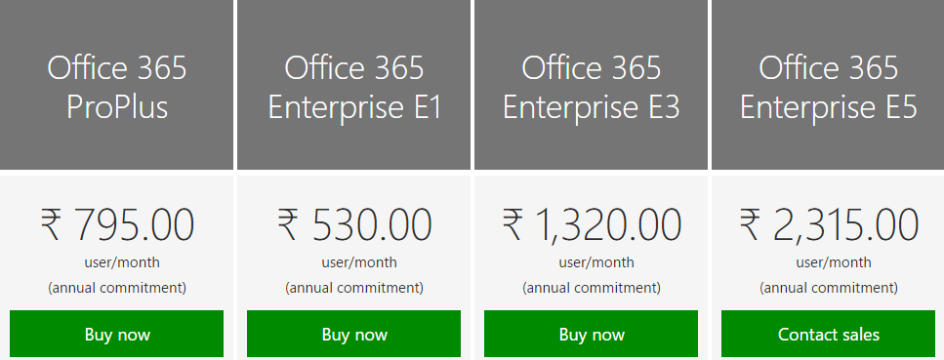
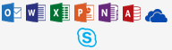

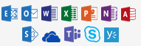
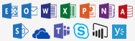
Pricing & Application “Microsoft Enterprise Office”
Enterprise (Monthly Cost)
https://products.office.com/en-in/business/compare-more-office-365-for-business-plans

Slide 8

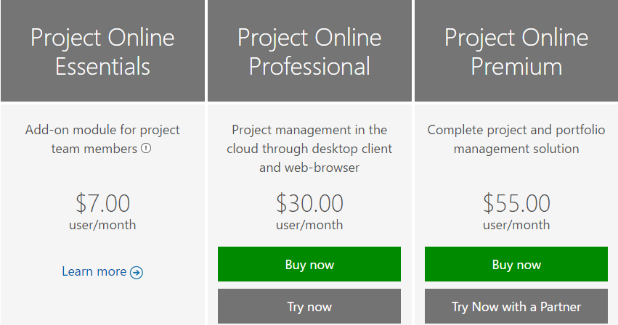
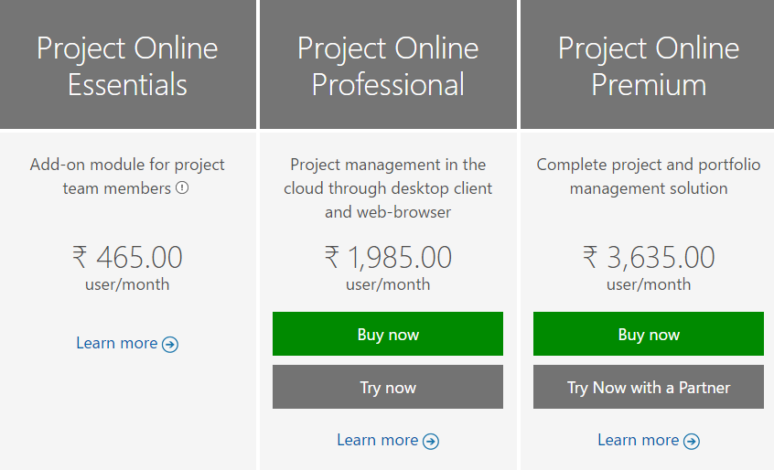
Pricing “Project Online” Products
https://products.office.com/en-us/project/compare-microsoft-project-management-software?tab=tabs-1
US$ Prices
https://products.office.com/en-in/project/compare-microsoft-project-management-software?tab=tabs-1
INR Prices

Slide 9

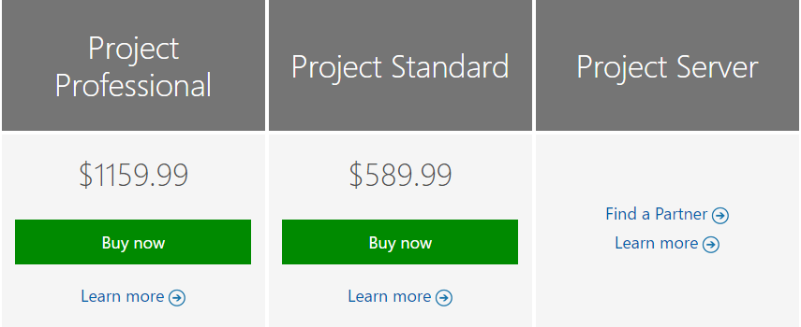
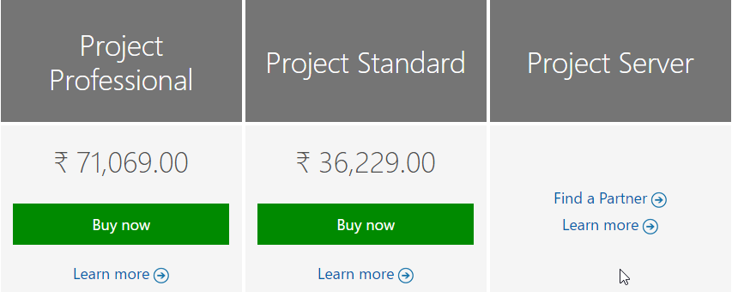
Pricing “Project Server” Products
https://products.office.com/en-us/project/compare-microsoft-project-management-software?tab=tabs-2
https://products.office.com/en-in/project/compare-microsoft-project-management-software?tab=tabs-2

Slide 10
Which “Project” License should I Purchase?
Cloud Based Solution – Online License | On Premise Solution- Perpetual License
1- Project Essential (For team members, to update timesheet, task update, risk, issue reporting) | Not possible in On Premise Solution. Unless you install Project Server and create users who have only this limited access. In this case they access the system through PWA.
No possible in cloud solution. But limited scheduling capability is available if you have Project Online Professional. | 4- Project Professional (Desktop Installation) https://products.office.com/en-us/project/project-professional-desktop-software You can connect to Project Online or Project Server with this license
No possible in cloud solution. But limited scheduling capability is available if you have Project Online Professional. | 5- Project Standard (Desktop Installation) https://products.office.com/en-in/project/project-standard-desktop-software You can NOT connect to Project Online or Project Server with this license
2- Project Online Professional (It is not replacement of desktop Project Professional/Standard) | 6- Project Server 2016 (Server Installation) https://products.office.com/en-in/project/enterprise-project-server You can use this only if you have server configuration hardware with other software (Windows Server, SQL Server, SharePoint Server) Forum: https://social.technet.microsoft.com/Forums/projectserver/en-US/home
3- Project Online Premium (With Portfolio Management Capability) | Available in On Premise solution if Project Server 2016 is full installed

Slide 11
Registration & Purchase

Slide 12
Type of Office 365 Account
Home
Work, School or University (https://login.microsoftonline.com)
To purchase Project Online License, you must have this license.
User emailed with “Work & Student” Account will be in this format- YourName@CompanyName.onmicrosoft.com

Slide 13
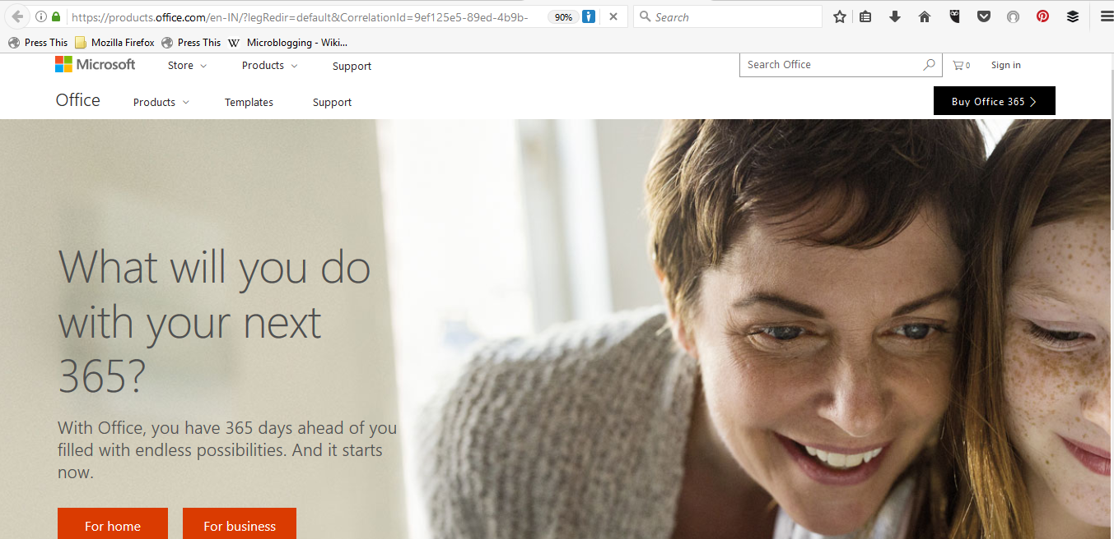
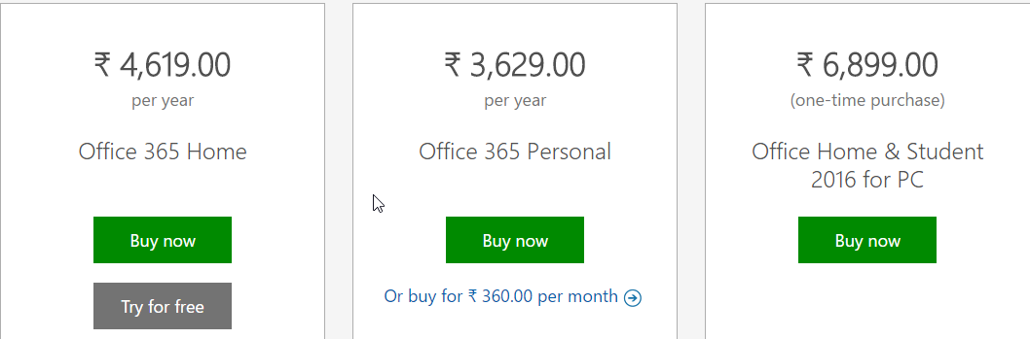
Buy or Download Trial Version – Office 365
https://products.office.com/en-in
1

Slide 14
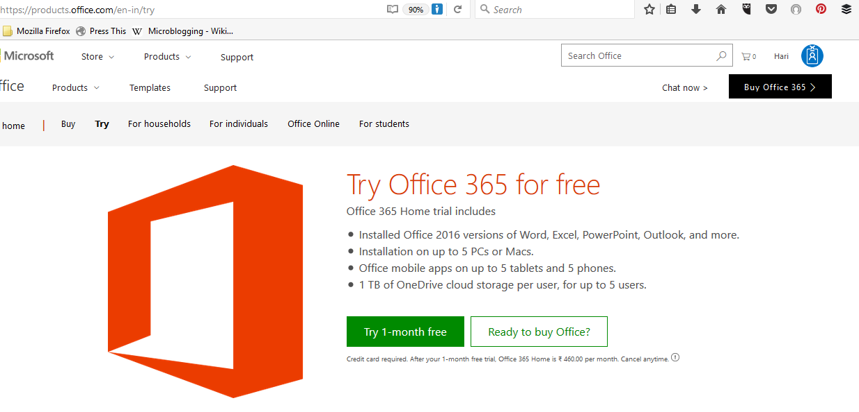
Free Trial Download, Try Microsoft Office 365 Products

Slide 15
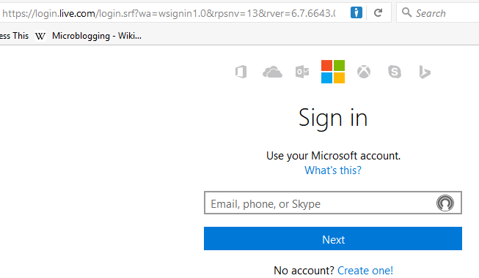
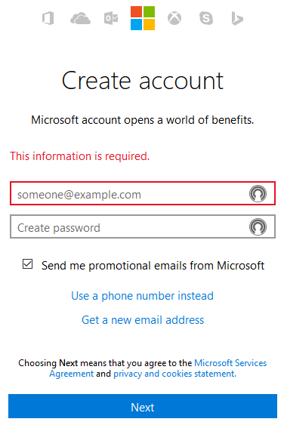
Create Office 365 – Home Account
1
2
3
4

Slide 16
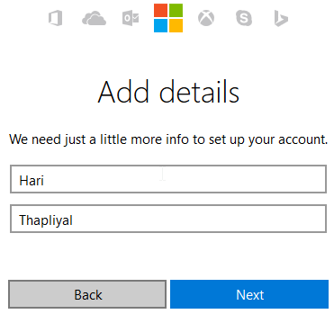
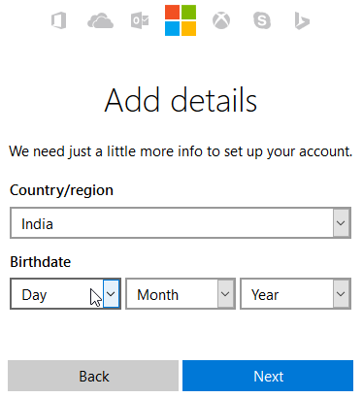
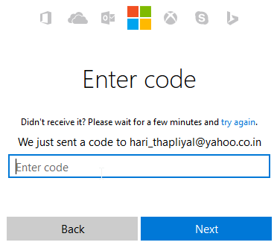
Create Office 365 – Home Account Cont…
5
6
7

Slide 17
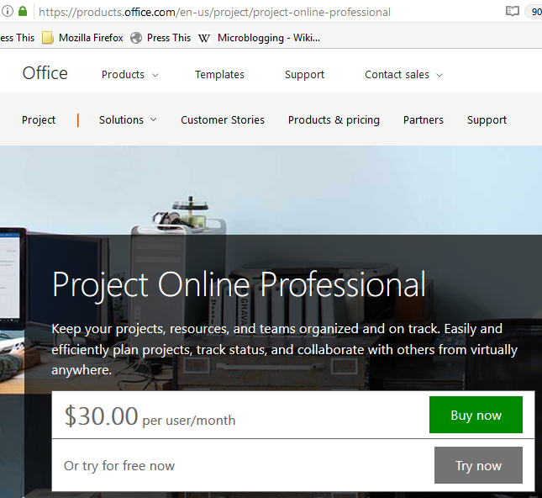
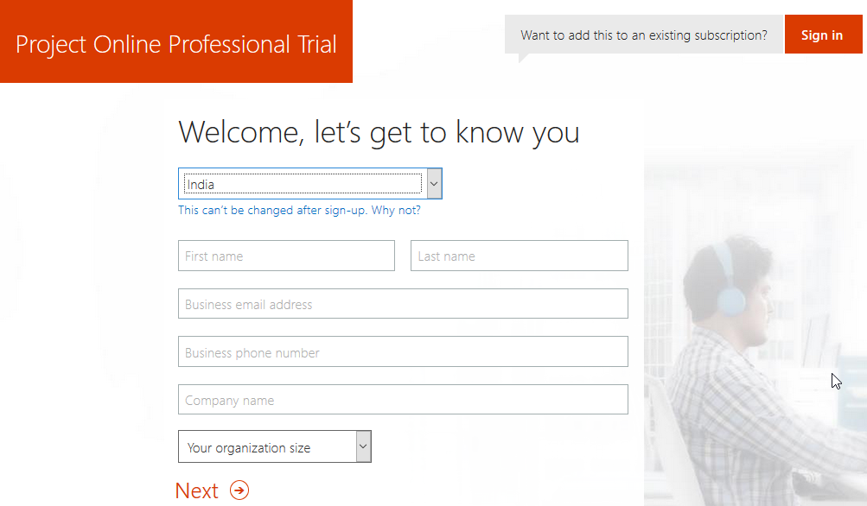
Create Office 365 – Work & Student Account
To purchase “Project Online” you need to have “Work or Student or University” Account

Slide 18
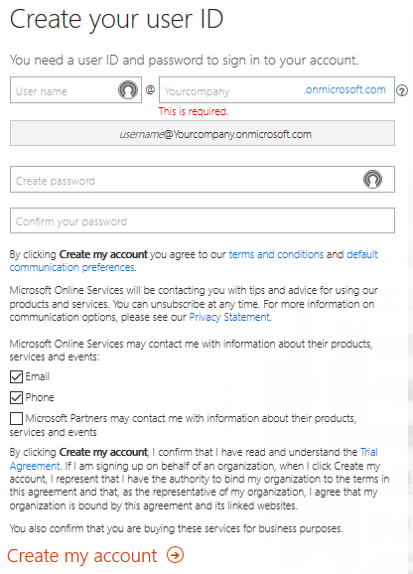
Create Office 365 – Work & Student Account Cont..
This is very important field. It is your domain name on Microsoft Office 365 Server. All you licenses and user names will be associated with this domain name.

Slide 19
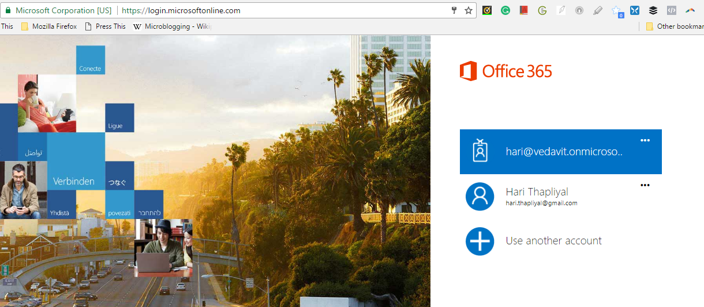
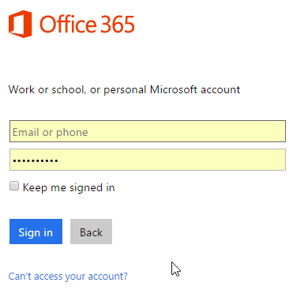
Login into Microsoft Online Account

Slide 20
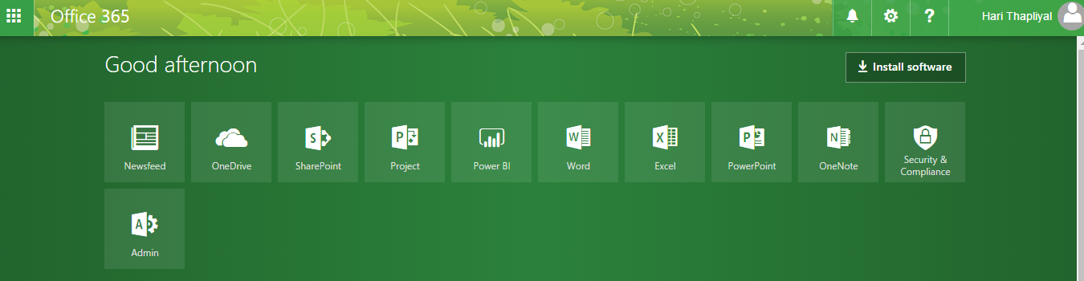
Main Screen (Office 365)
https://www.office.com

Slide 21
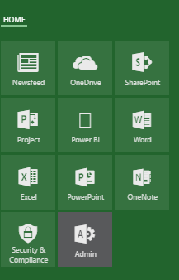
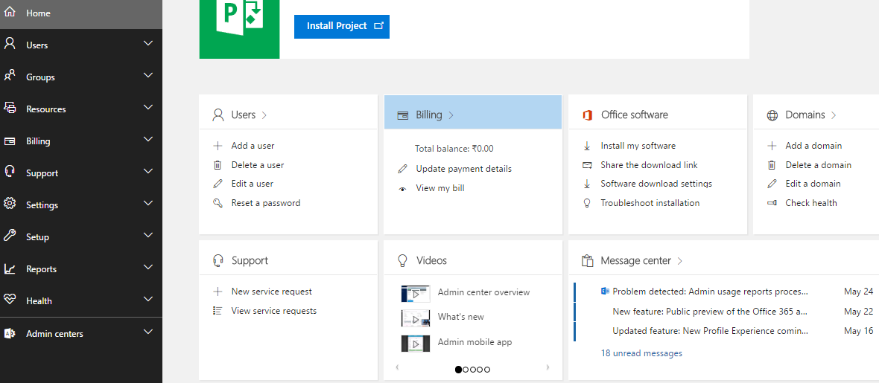
Office 365: Admin
https://portal.office.com/adminportal/home#/homepage

Slide 22
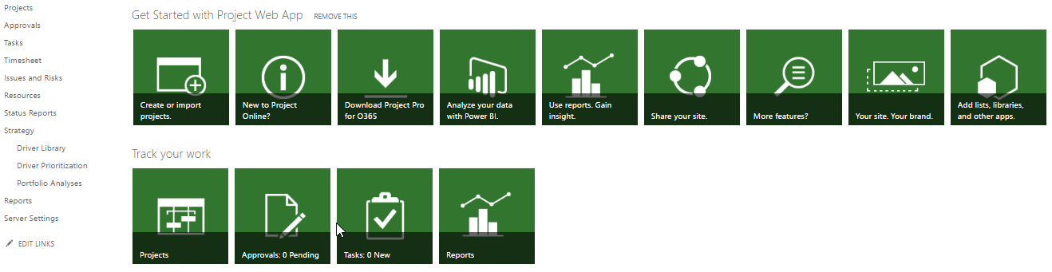
Office 365: Project
https://vedavit.sharepoint.com/sites/pwa/default.aspx

Slide 23
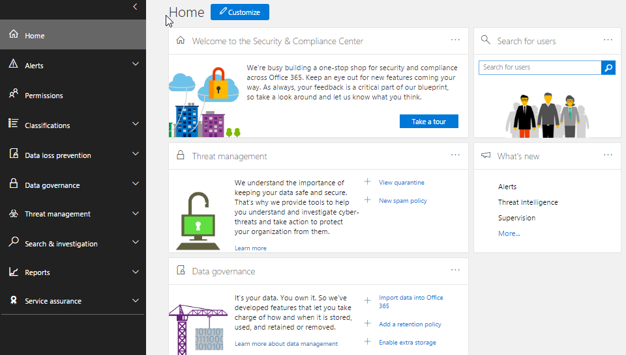
Office 365: Security & Compliance
https://protection.office.com/#/homepage

Slide 24
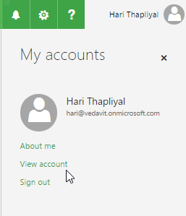
View Account

Slide 25
Admin

Slide 26
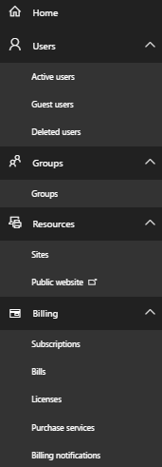
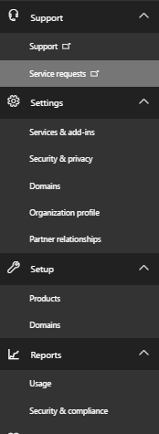
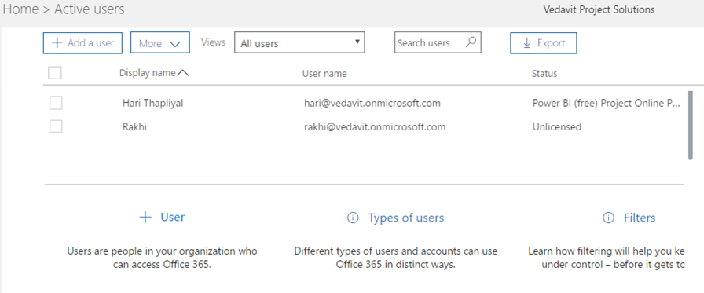
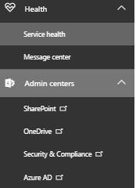
Users > Add User
https://portal.office.com/adminportal/home#/users
1
1
2
Adding New User Licensed User to Office365

Slide 27
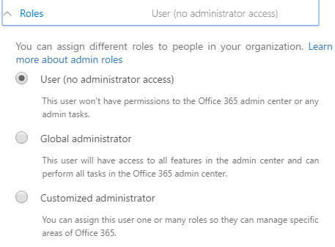
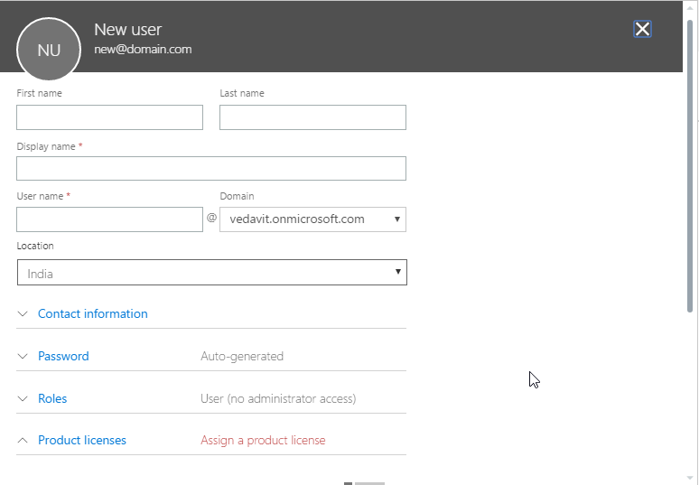
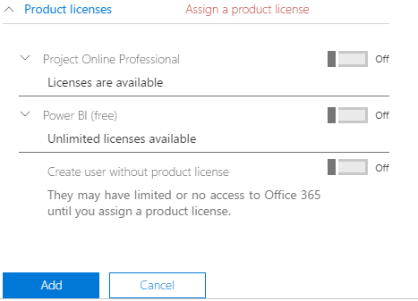
Users > Add User Cont…
4
3
Adding New User Licensed User to Office365
5

Slide 28
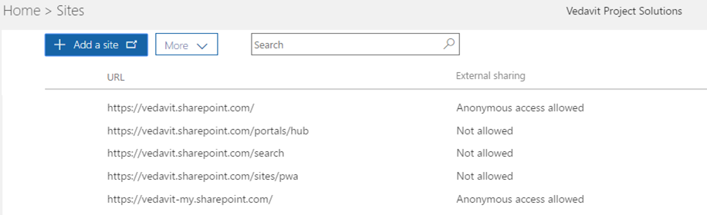
Resources> Site
https://portal.office.com/adminportal/home#/SitesList
Creating New SharePoint Site

Slide 29
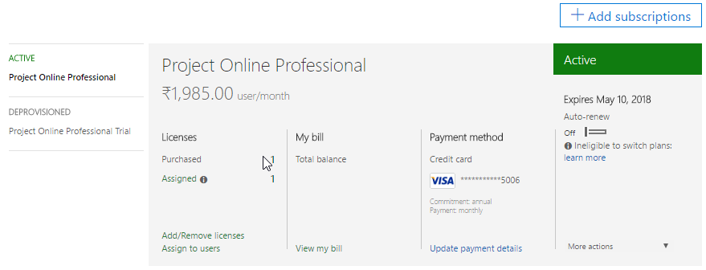
Billing > Subscription > Set Auto-Renew Off
1
1
2

Slide 30
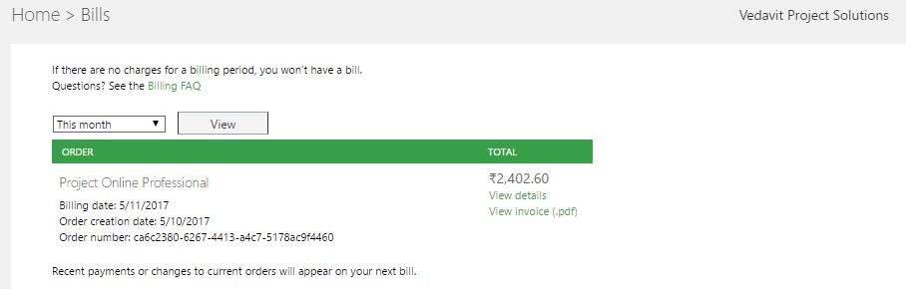
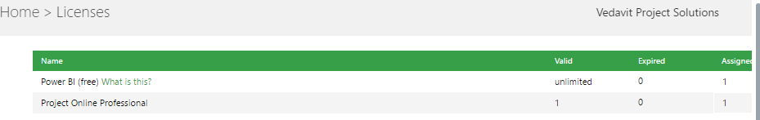
Billing > Bills & Licenses

Slide 31
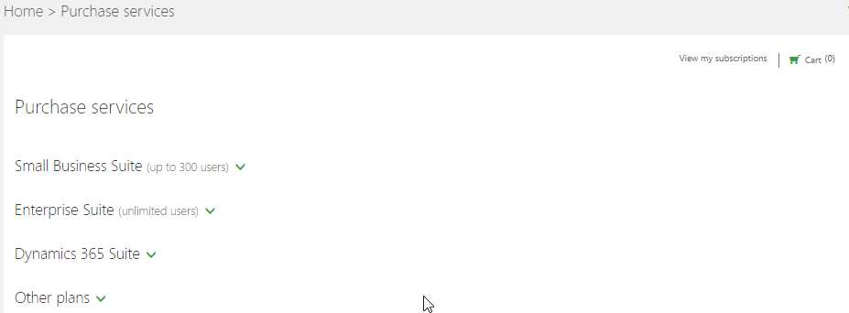
Billing> Purchase Services

Slide 32
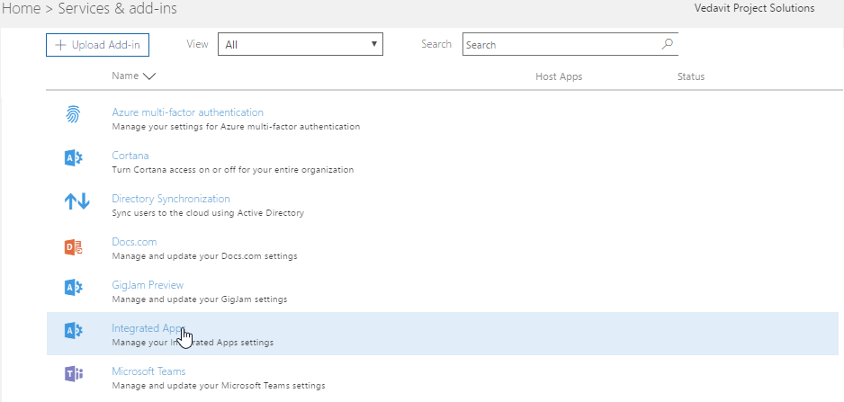
Setting > Services & Add-ins

Slide 33
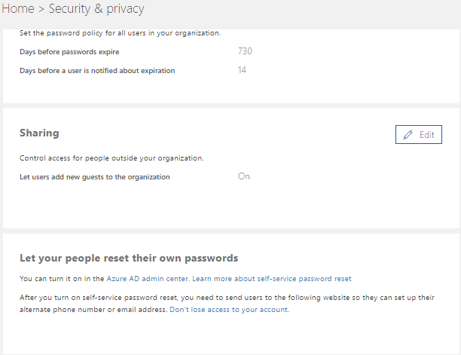
Setting > Security & Privacy

Slide 34
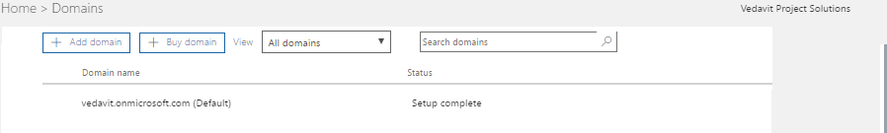
Setup > Domain
https://portal.office.com/adminportal/home#/Domains

Slide 35
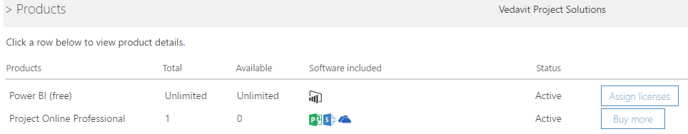
Setup > Products Purchased by You

Slide 36

Health > Service Health
https://portal.office.com/adminportal/home#/servicehealth

Slide 37
Project

Slide 38

My account (View 1- Via portal.office.com)
1
2

Slide 39

Get Started with Project Web App (View 2)

Slide 40
Project Online Professional Supports
1300 Resources
10000 Projects

Slide 41
View Account

Slide 43

My account

Slide 44

My account

Slide 45

My account

Slide 46

My account

Slide 47

My account

Slide 48

My account

Slide 49

My account

Slide 50
Security & Compliance

Slide 51

Security & Compliance
https://protection.office.com/#/homepage

Slide 52




Protection > Home
https://protection.office.com/#/homepage

Slide 53








hari.prasad@vedavit-ps.com
+91 9535999336
https://in.pinterest.com/harithapliyal
https://www.instagram.com/thapliyal.h
https://in.linkedin.com/in/harithapliyal
http://twitter.com/pmlogy
http://pmlogy.com/
http://facebook.com/harithapliyalpage

